Slide 1


NYPD Shooting Incident Data Report
5301: Data Science as a Field
University of Colorado Boulder
DATA SCIENCE

Slide 2
Exploring NYPD Shooting Incident Data (Historic)
Introduction
Goal
Gun Violence
DATA SCIENCE
Notes:
Hello everyone! I’m Dustin, and today I'm thrilled to share insights from my analysis of historic NYPD shooting incident data as a final project for Data Science as a Field. Our goal is to use R to uncover patterns and trends within the numbers. So, let's embark on this data exploration journey together.
Before we jump into the data, let's take a moment to acknowledge the gravity of the issue we're addressing. Gun violence is a pressing concern that affects communities worldwide. By delving into the data, we aim to contribute to a better understanding of this complex problem and, hopefully, find insights that can guide future actions.

Slide 3

Data Source
DATA SCIENCE
Notes:
Our journey begins with the dataset itself. I've sourced the data from Data.gov, a platform that provides a wealth of valuable datasets. The NYPD shooting incident data we're using is a historical record that spans from 2006-2022
Data.gov is the United States government's open data website. It provides access to datasets published by agencies across the federal government. Data.gov is intended to provide access to government open data to the public, achieve agency missions, drive innovation, fuel economic activity, and uphold the ideals of an open and transparent government.

Slide 4
Objectives of the Analysis
Get familiar with R and Rmd
Find something interesting within the data
Use a model to uncover trends
DATA SCIENCE
Notes:
So, what are we hoping to achieve with this analysis? Our main objectives include
. By the end of this presentation, I aim to provide you with a deeper understanding of the patterns and trends present in the NYPD shooting incident data.

Slide 5
Steps in the Analysis
Data preparation
tidyverse
Exploratory analysis
`summary`, `head`
Visualizations
ggplot
Statistical analysis
Chi-squared
DATA SCIENCE
Notes:
Now, let's walk through the steps I took to extract meaningful insights from the data. We'll start with the data preparation (utilizing tidyverse), move on to exploratory data analysis (utilizing summary, head, and other built in r functions), visualizations (using ggplot), and finish with a statistical analysis that unveils patterns within the dataset.

Slide 6
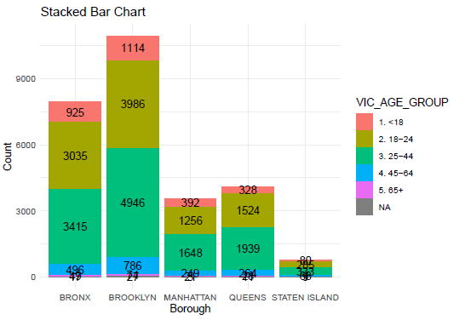
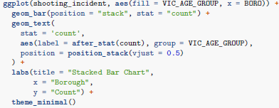
Visualizations (1)
DATA SCIENCE
Notes:
After exploring the data, I identified I wanted to find if there are trends between victims, their ages, and their borough. Our first stop on this visual journey is a stacked bar chart showcasing the distribution of age groups across different boroughs. Using ggplot, I was able to create that stacked bar chart which shows how incidents are spread among various age groups.

Slide 7
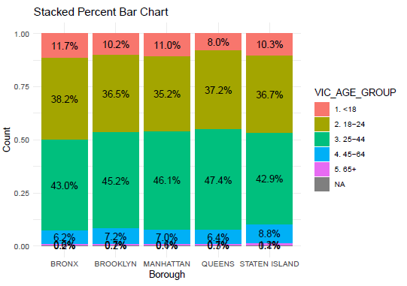
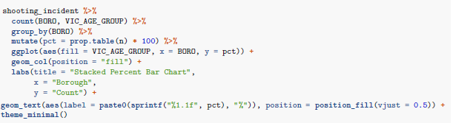
Visualizations (2)
DATA SCIENCE
Notes:
The stacked bar chart was a little hard to understand since the populations of the borough are pretty varied. To enhance clarity, I've also created a stacked percent bar chart. This provides a clearer comparison of the age group distribution in each borough. Percentages help us understand the relative impact in a more accessible way. We can see that as a % of all victims in the boroughs, 18-24 year olds make up a smaller % in
Manhattan than the other boroughs, and 25-44 year-olds make up a smaller % in the Bronx

Slide 8
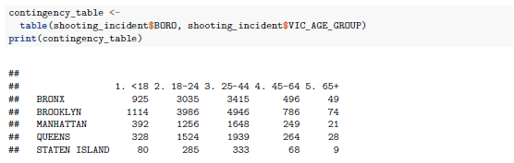

Statistical Analysis
DATA SCIENCE
Notes:
Now, let's get a bit technical. I applied a chi-squared test of homogeneity to determine if the distribution of shooting incidents among age groups is the same across different boroughs. To start, I needed to create a contingency table, then I ran the chi-squared test. The low p-value we obtained indicates that there are indeed significant differences.

Slide 9
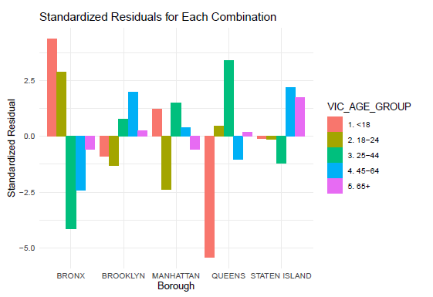


Standardized Residuals
DATA SCIENCE
Notes:
But what does this statistical significance mean in practical terms? The standardized residuals help us pinpoint exactly where these differences lie.
I first turned the standardized residuals into a data frame, and then used ggplot to graph the results
The graph reveals which age groups and boroughs contribute most significantly to these variations. The outsized negative standard residual in ‘<18’ year-olds in Queens show
they are less likely to be victims, while in the Bronx, the higher standard residual shows anyone less than
24 is more likely (and then the opposite for those aged 25-64).

Slide 10

Final Thoughts – Bias Identification/Reduction
DATA SCIENCE
Notes:
Before we conclude, it's essential to acknowledge the limitations of our analysis. While statistical significance is valuable, we must approach these findings with caution. Real-world complexities and inherent biases in the data may impact the practical implications of our results.

Slide 11
Thank You!
Bullet 1: Use the font Arial
Bullet 2: Don’t go bullet crazy – speak to your audience, don’t make them read a lot
Bullet 3: Keep it simple

